Slide 1
BI - PROJECT
CENSUS REPORTING SYSTEM
BY-
SAKSHAM ARORA
3000181

Slide 2
Abstract of the project
A Census is the procedure of systematically acquiring and recording information about the members of a given population.
The Population Census is the most detailed information source on the population at the level of small localities and small groups in population.
The purpose of this project is to gather information about general population in order to present a full and reliable picture of population in Cities.
It collects data on many attributes of population, not just for the count of people, although population estimates remain an important function of Census.

Slide 3
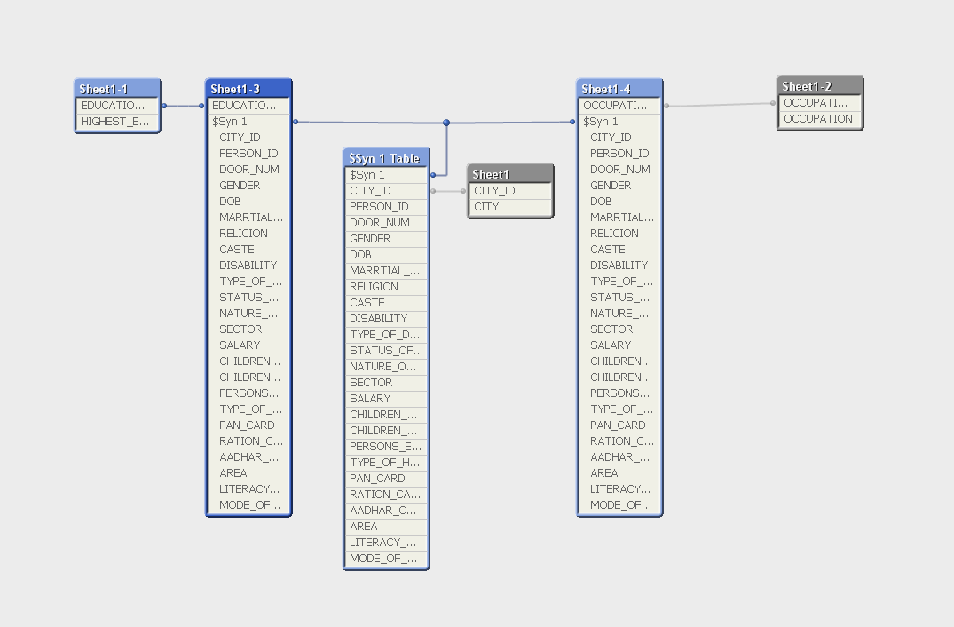
SCHEMA STRUCTURE

Slide 4
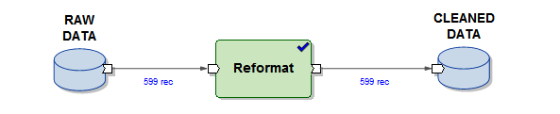
ABINITIO GRAPH - 1

Slide 5
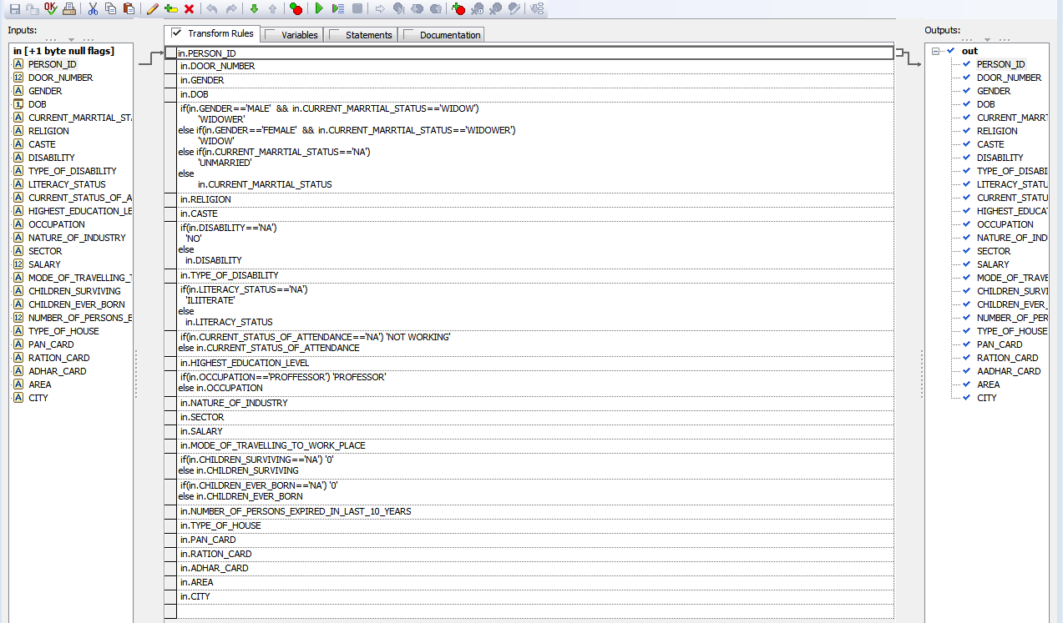
REFORMAT

Slide 6
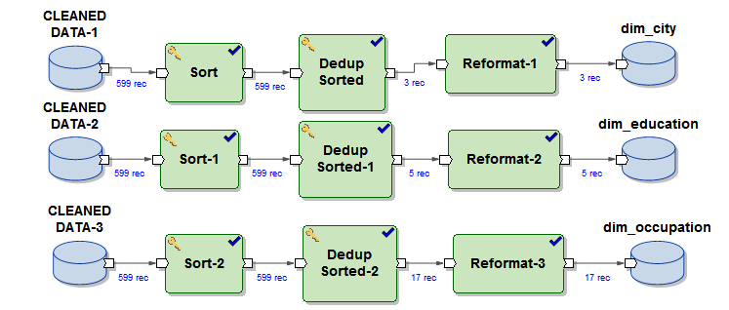
ABINITIO GRAPH - 2

Slide 7
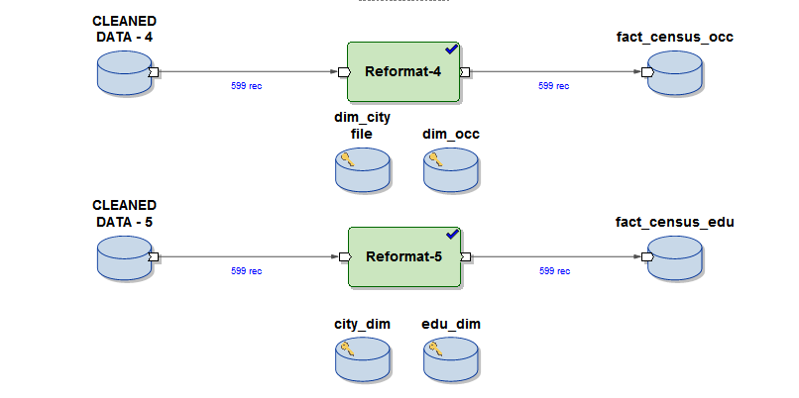
ABINITIO GRAPH - 3

Slide 8
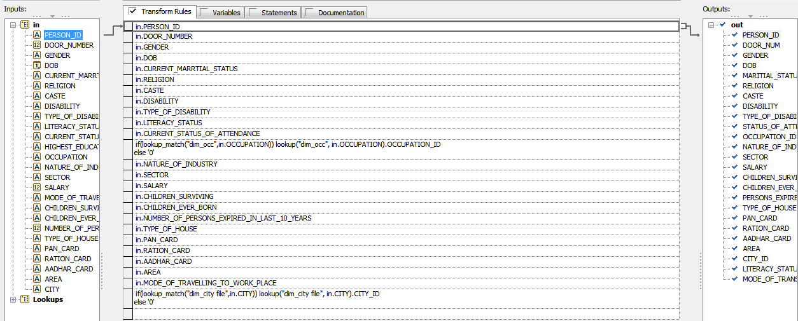
REFORMAT - 4

Slide 9
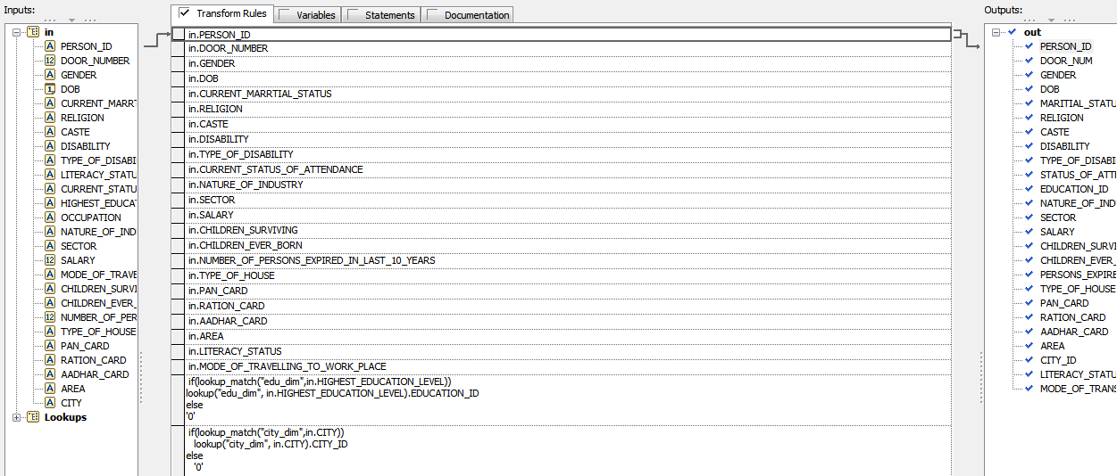
REFORMAT - 5

Slide 10
SAMPLE REPORTS

Slide 11
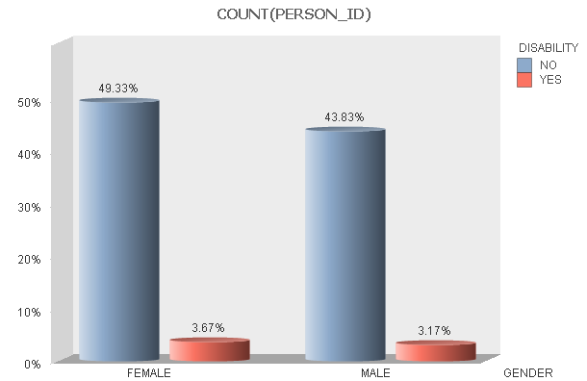
1.DISABLE PEOPLE WISE POPULATION
DENSITY

Slide 12
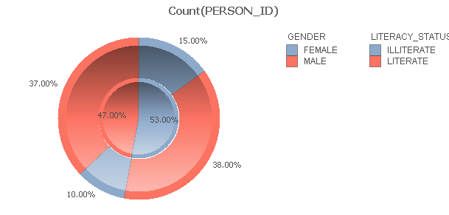
2. LITERATE PEOPLE WISE POPULATION
DENSITY

Slide 13
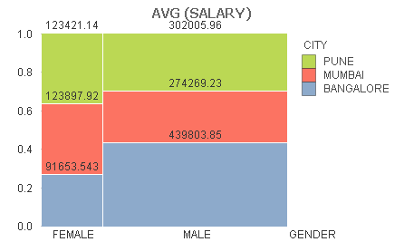
3. AVERAGE SALARY OF GENDER ACCORDING CITY WISE

Slide 14
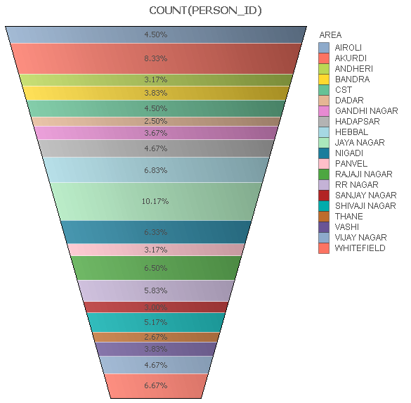
4. DEATH RATES AREA WISE

Slide 15
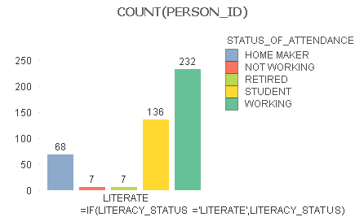
5. STATUS OF ATTENDANCE BASED ON LITERACY STATUS

Slide 16
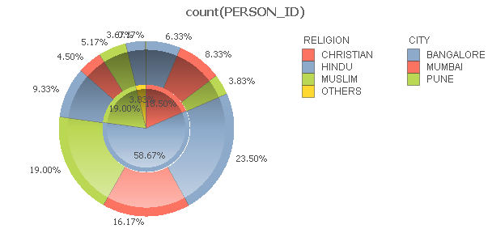
6. RELIGION IN DIFFERENT CITIES

Slide 17
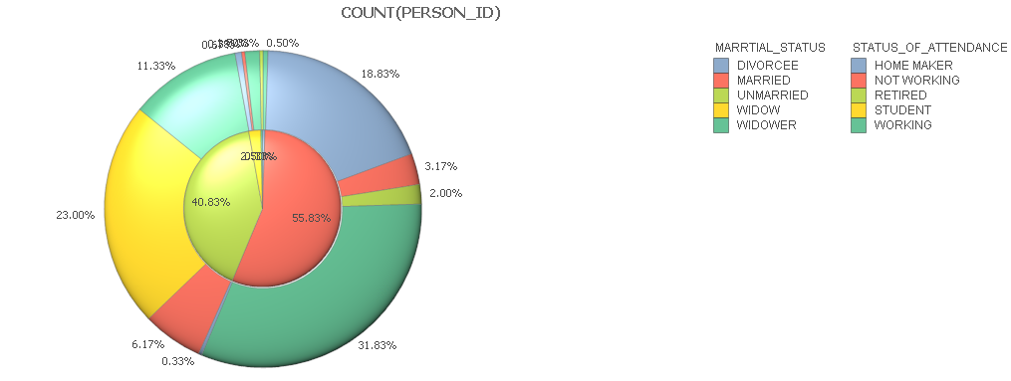
7. MARITIAL STATUS WISE CLASSIFICATION

Slide 18
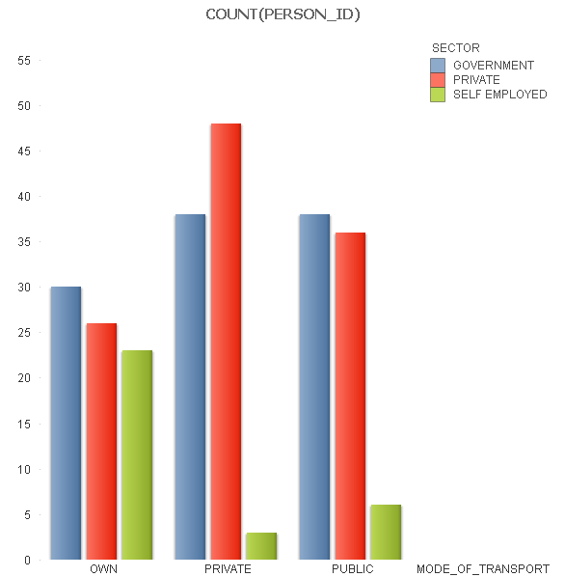
8. MODE OF TRANSPORT IN SECTOR

Slide 19
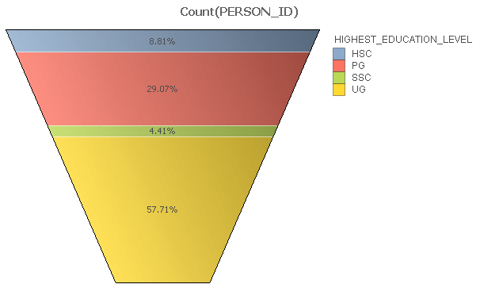
9. Education wise classification (SSC,HSC,UG &PG)

Slide 20
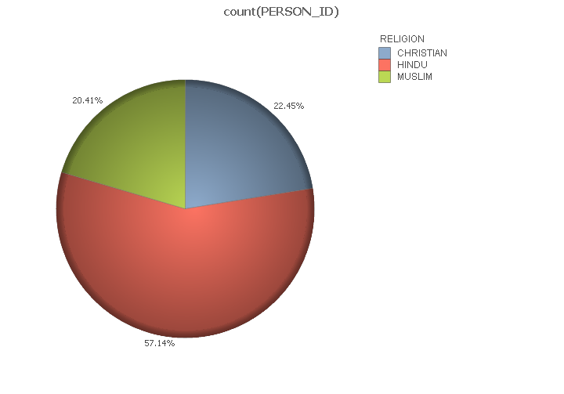
10. Religion(Hindu, Muslim, Christian)

Slide 21
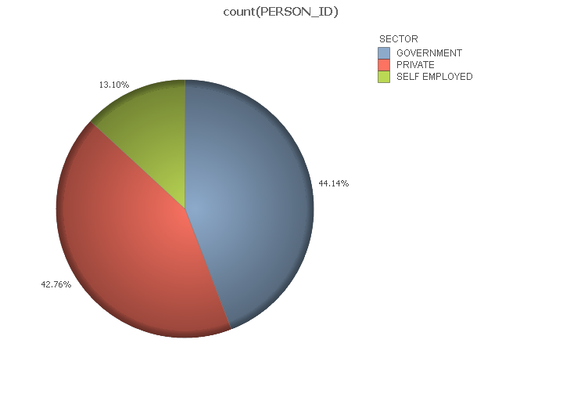
11. Job wise classification (government, private & self employed)

Slide 22
THANK YOU!

